Slide 1


Road Trip Assistant
HELPING YOU DRIVE WITH CONFIDENCE
Presented by: Colin Liu, Robert Bailey & Simon Li

Slide 2


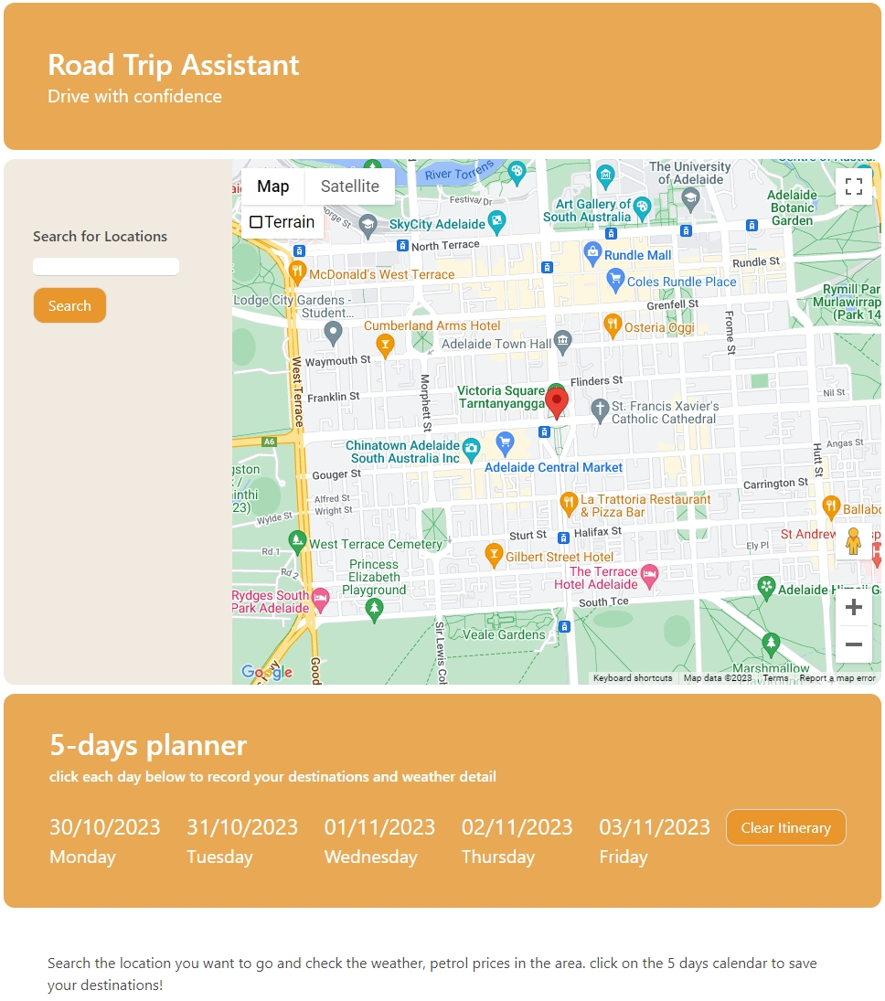

Features (CL)
Search function for any town and city in Australia
This will return the relevant petrol price average and five-day weather forecast
Displays Google Maps, to show surrounding area info
5-days planner for the user to record the trip plan in the next 5 days

Slide 3
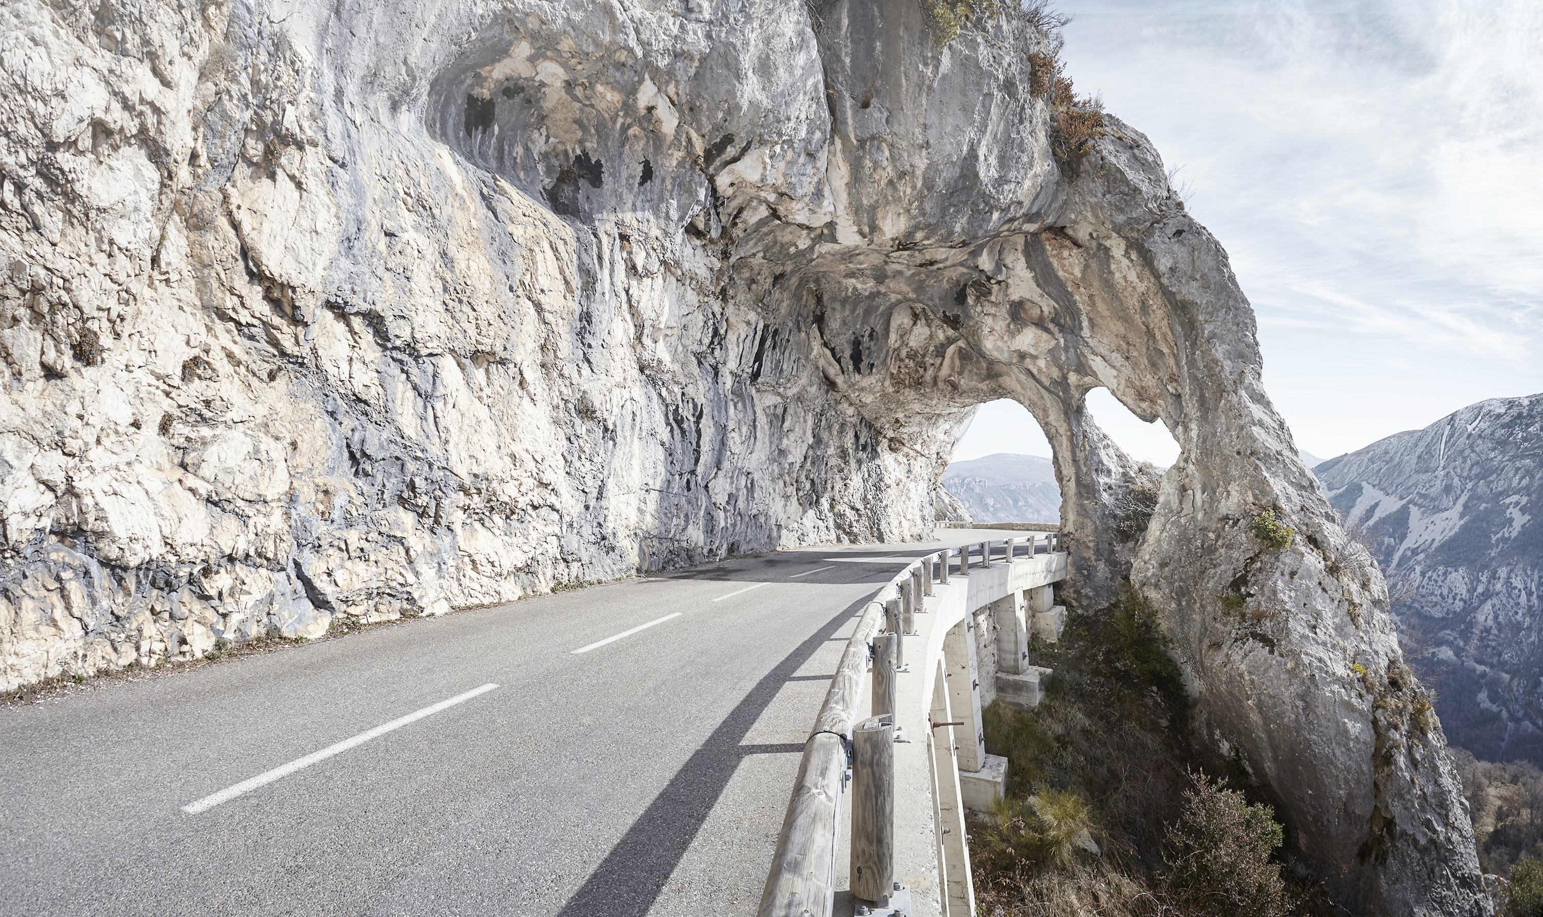
Concept (RB)
Description:
Combining a few helpful apps and sources of info into one, which a user can search and see at the same time, while on the road.
Motivation:
Planning a road trip needs to go across a few websites to get enough information for travelling, this page could help to get all info in one place.
User Story:
When I plan and start a road trip, I want an app that can show the location map and relevant travel information, such as the petrol prices and weather forecast. I also want to have a calendar to store my short trip plan.

Slide 4

Process (CL)
Technologies used:
- Coding:
HTML, CSS, JS
- 3rd party APIs:
Bulma CSS framework, Jquery & Jquery UI
- Server side Apis:
google map, weather org, fuelprice widget

Slide 5

Process (CL)
Developers’ roles:
- Concept & Ideas: CL & RB
- HTML CSS framework: CL
- CSS enhance & UI polish: SL
- Api investigation and integration: CL & RB
- JS function:
CL(search Btn, 5-days planner function)
RB(weather api, 5-days planner weather info)
SL(5-days planner dates)
-Debug & consolidation: CL

Slide 6

Process (the Team)
Challenges:
-Lack of petrol APIs around compared with weather APIs, or not as easy to implement seemingly
-Personal skill and knowledge level
-Server side Api doc reading and interpreting
-codes merging conflicts

Slide 7

Process (the Team)
Successes:
-Quite simple and efficient when adding in the Google Maps API, seems to be well-established technology
-team work success
-the final integration is well

Slide 8
Process (SL)
Dynamic Date Display Using JavaScript:
Steps:
Get the current date.
Loop through a set number of elements.
Calculate and format dates.
Update HTML elements with formatted dates.
Get Current Date
For Loop
Set iteration times
Date Calculation
Date Formatting
HTML output

Slide 9
DEMO！ (SL)

Slide 10

Directions for future development
(the Team)
CL：
“fuel api could be better, the Calander could expend to a monthly span, distance between planned locations could be useful and worth to integrate in the future, memo functions could be useful as well”
RB:
“If more, better developed petrol price APIs become available, like with the weather APIs and Google Maps API, it could help developers of apps like this, Be able to more easily show petrol prices for individual petrol stations or suburbs, an original intention for this app”

Slide 11

Links
Repo Link:
https://github.com/mkdkck/roadTripAssistant
Deployed Link：
https://mkdkck.github.io/roadTripAssistant

Slide 12
Thank you for listening

